Slide 1
Designing a Resilient and Secure Network Infrastructure
Presented By: (Group -7)
Gyaneswar Sai bandaru - 11733856
Avinash Reddy Gangapuram - 11589813
Rakesh Reddy Jammuladinne - 11721035

Slide 2
Virtual Lab Setup
Tools used: GNS3 for emulation and VMware for virtual machines.
Machines integrated: Attack Machine, Ubuntu Server, and Remote Machine.
Verified setup using ping and traceroute to ensure connectivity.
GNS3 Web UI checked server-client links and topology changes.

Slide 3
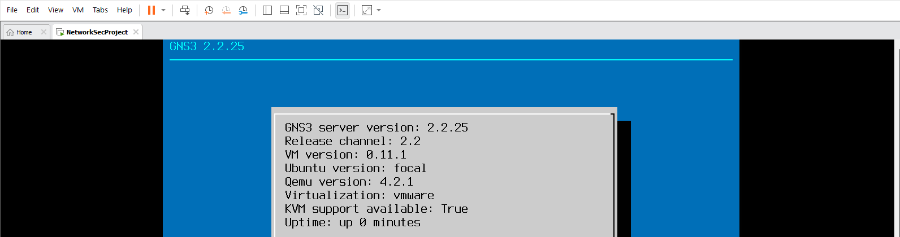
Lab Environment Setup" – Shows GNS3 linked with VMware to simulate a real-world network

Slide 4
Network Design and Segmentation
Logical architecture included VLANs, DMZ, and internal networks.
VLANs: IT (10), Finance (20), and Guest (30).
DMZ hosted web and mail servers for public interaction.
ACLs ensured that Guest VLAN could not access IT and Finance VLANs.
Inter-VLAN routing was configured via Sub-Interfaces on the Layer 3 switch.

Slide 5
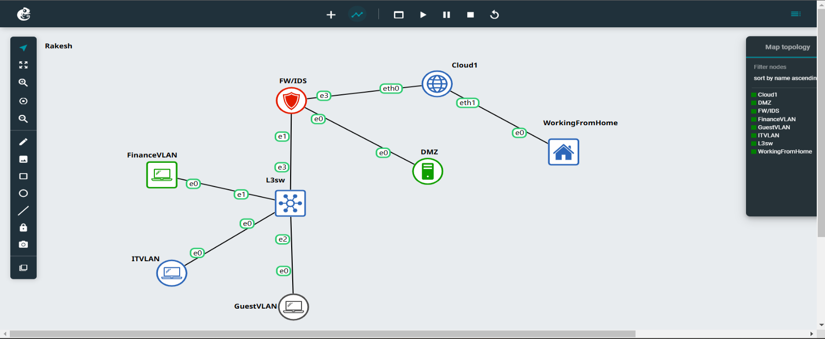
Network Topology Diagram – Highlights the segmented network with VLANs and DMZ for enhanced security

Slide 6
VLAN Configuration
VLANs were created and assigned to respective ports.
VLAN 10: IT resources (IP: 192.168.10.1).
VLAN 20: Finance systems (IP: 192.168.20.1).
VLAN 30: Guest access only (IP: 192.168.30.1).
ACL restricted communication between VLANs to only necessary traffic.

Slide 7
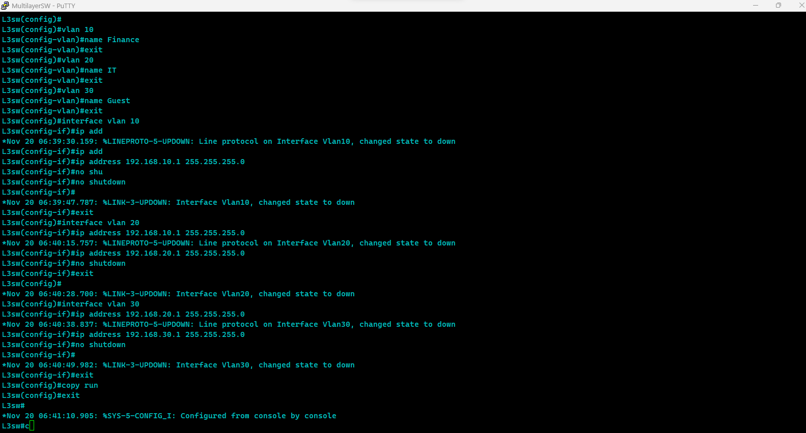
VLAN Routing Example– Displays VLAN configurations and access rules for isolated communication

Slide 8
Firewall Deployment
Ubuntu Server was used as a firewall with three interfaces:
WAN (Dynamic IP via DHCP).
LAN (Static IP: 192.168.1.1).
DMZ (Static IP: 192.168.2.1).
iptables was installed and configured for traffic control.
Default policies blocked all traffic except established or necessary connections.

Slide 9
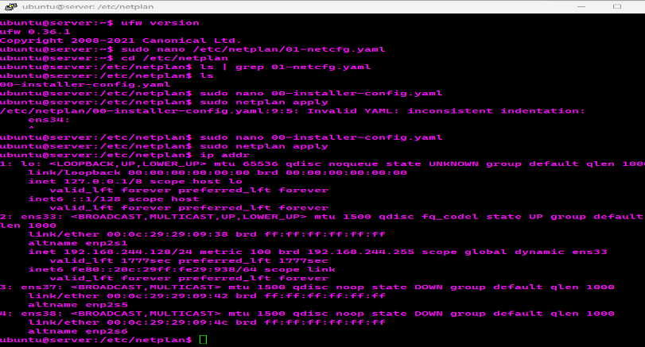
Firewall Interface Configuration – Illustrates WAN, LAN, and DMZ setup for traffic control.

Slide 10
Firewall Rules
SSH allowed only on WAN for remote management.
LAN communication with DMZ allowed for essential services.
HTTP and HTTPS permitted for DMZ via WAN.
NAT enabled internet access for LAN and DMZ.
Logging rules captured dropped packets for monitoring.

Slide 11
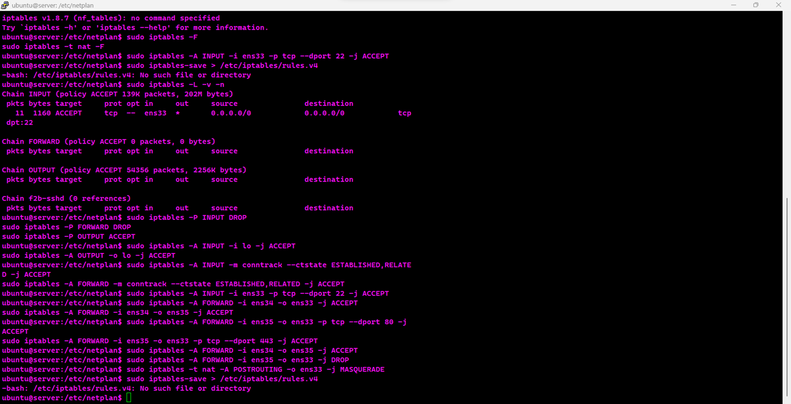
Firewall Rules in Action – Shows iptables rules restricting access to critical resources.

Slide 12
OpenVPN Deployment
OpenVPN was configured for secure remote access to internal networks.
Certificate Authority generated keys and certificates for encryption.
Server.conf setup included AES-256-CBC encryption and SHA256 authentication.
Firewall rules allowed VPN traffic on UDP port 1194.
Client access was tested using configuration files.

Slide 13
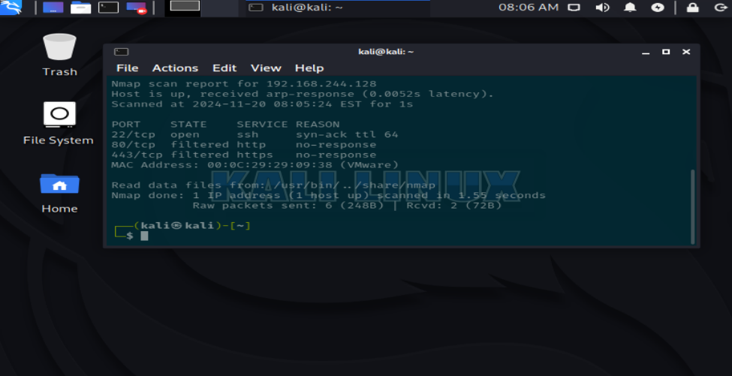
OpenVPN Client Configuration – Demonstrates secure remote access setup with certificates.

Slide 14
IDS/IPS Implementation
Snort was used for intrusion detection and prevention.
Default and custom rules set up for monitoring, e.g., SSH brute force detection.
Attack traffic simulated using Kali Linux confirmed Snort’s detection capabilities.
Logs identified violations and triggered alerts.

Slide 15
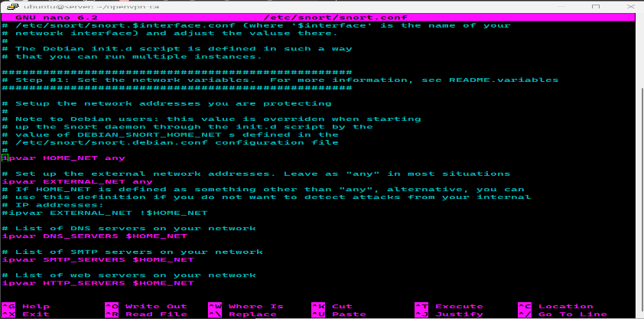
Snort Log Details– Displays intrusion detection logs triggered by simulated attacks.

Slide 16
Testing and Security Assessment
Security testing conducted using Nmap and Metasploit.
Results: All ports filtered except SSH (22).
SSH service secure against brute-force and exploitation attempts.
Misconfigurations identified, e.g., exposing port 22 to the internet.
Penetration tests demonstrated strong security with minor areas for improvement.

Slide 17
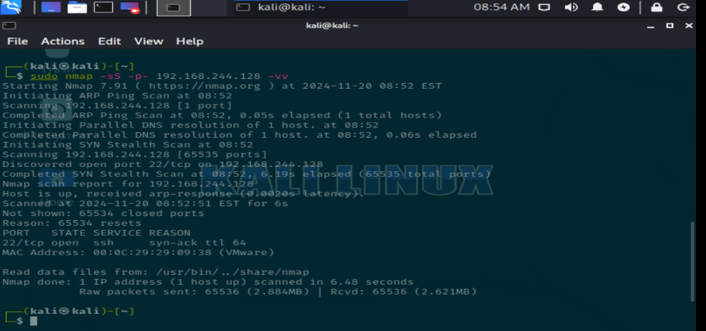
Nmap Scan Results – Highlights open ports and confirms proper firewall settings.

Slide 18

Risk Mitigation Strategies
Restrict access to essential ports only (e.g., close unused ports).
Regularly update configurations to comply with security standards.
Use tools like fail2ban to limit brute force attacks.
Conduct routine vulnerability assessments and audits.

Slide 19
Conclusion
The network isolates threats and ensures secure remote access.
VLANs, firewalls, and IDS/IPS provide multi-layered protection.
Testing shows the system is robust with minor areas for improvement.
Continuous monitoring and updates are key to maintaining security.

Slide 20
Thank you!

